Slide 1







How to read a Research Paper
Scientific reading in the age of AI
Marius Klug
he/him
PI Young Investigator Group Intuitive XR
Chair of Neuroadaptive Human-Computer Interaction
Brandenburg University of Technology Cottbus-Senftenberg
marius.klug@b-tu.de
discord.gg/7MJjQ3f
twitch.tv/intuitivexrlabs

Slide 2

What not to do
Do not read a paper like a book or a story!
discord.gg/7MJjQ3f
twitch.tv/intuitivexrlabs

Slide 3

What to do
Read the paper in a structured way
discord.gg/7MJjQ3f
twitch.tv/intuitivexrlabs

Slide 4
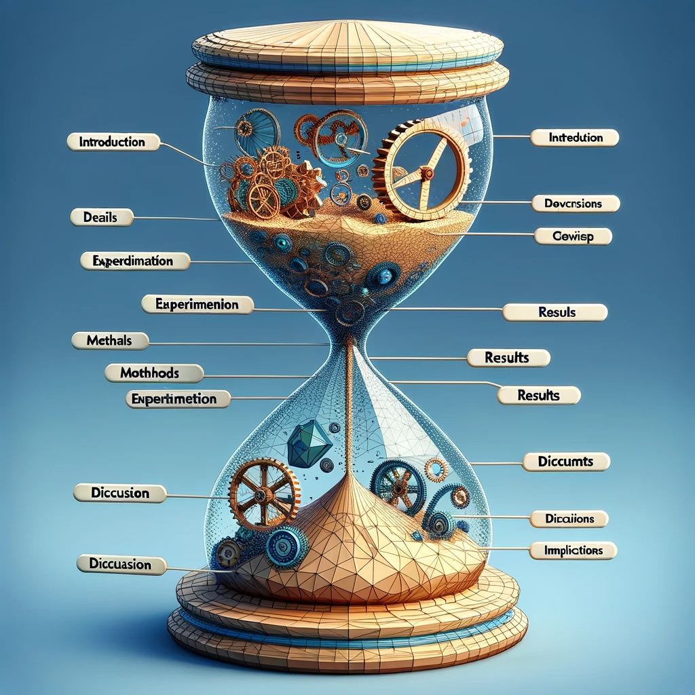
What is a paper
Title
Abstract
Introduction
Methods
Results
Discussion
Conclusions
discord.gg/7MJjQ3f
twitch.tv/intuitivexrlabs

Slide 5
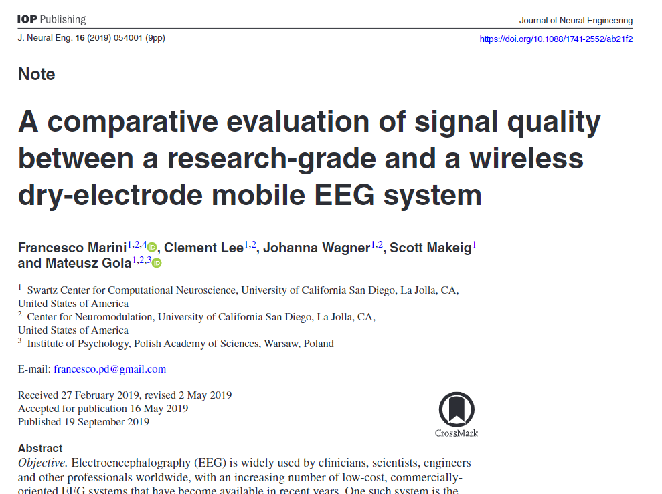
What is a paper
Journal / Year
Title
Authors
Affiliations
Contact
discord.gg/7MJjQ3f
twitch.tv/intuitivexrlabs

Slide 6
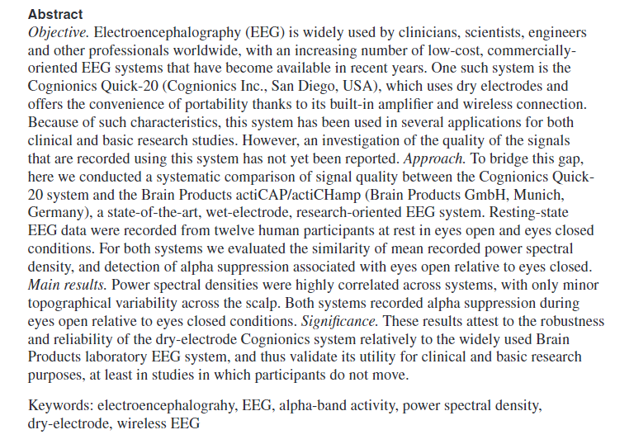
What is a paper
discord.gg/7MJjQ3f
twitch.tv/intuitivexrlabs

Slide 7
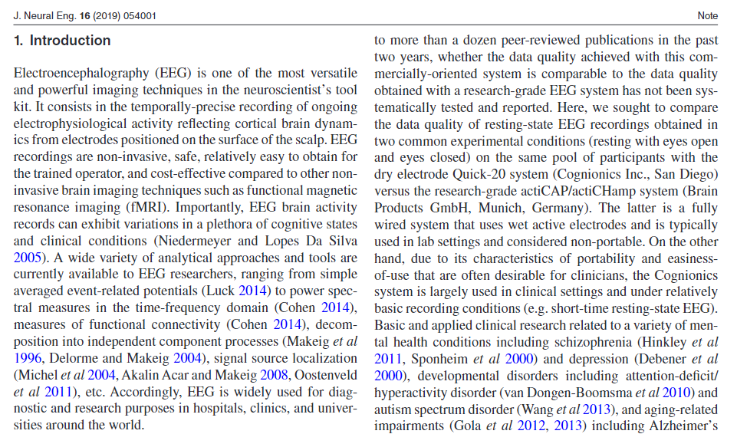
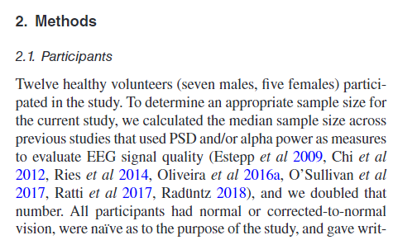
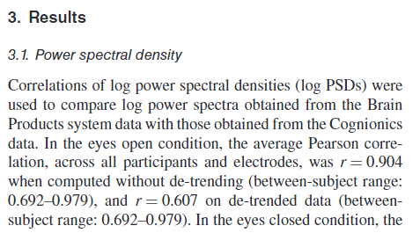
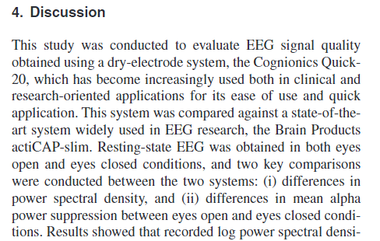
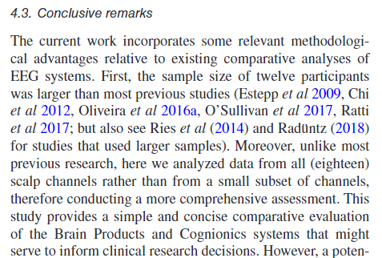
What is a paper
discord.gg/7MJjQ3f
twitch.tv/intuitivexrlabs

Slide 8

The brief check paper-reading approach
Why?
Someone links you a paper and you need to evaluate if it is worth reading it
You need to quickly make sure you have an idea of the topic for the seminar
You found a reference to a paper in a paper you read and need to check it
You try to win an argument…
discord.gg/7MJjQ3f
twitch.tv/intuitivexrlabs

Slide 9
The brief check paper-reading approach
Shrink it down to 1-2 pages (10-30 minutes):
Read title carefully to grasp the topic and main finding
Check abstract to get briefed on the entire study
Look at figures to see experiment design and main results
Read conclusions to find the main contributions to the field
-> You now know all key points of a paper!
discord.gg/7MJjQ3f
twitch.tv/intuitivexrlabs

Slide 10
The brief check paper-reading approach
Title
Introduction
Methods
Results
Discussion
References
Abstract
Conclusions
discord.gg/7MJjQ3f
twitch.tv/intuitivexrlabs

Slide 11

What you know after a brief check
The four Generals:
General topic of the paper
General knowledge gap / problem statement
General experimental approach
General results
Most of the time one does not read much further than this!
discord.gg/7MJjQ3f
twitch.tv/intuitivexrlabs

Slide 12

The detailed reading
Why?
You found the paper to be interesting in your brief check
You need to go deep into the topic for your seminar or essay
You want to learn more about that particular field of research
You want to learn more about the methods and maybe replicate the ideas
You want to understand thoroughly the logical argumentation of the authors
discord.gg/7MJjQ3f
twitch.tv/intuitivexrlabs

Slide 13
The detailed reading
Title
Introduction
Methods
Results
Discussion
References
Abstract
Conclusions
discord.gg/7MJjQ3f
twitch.tv/intuitivexrlabs

Slide 14
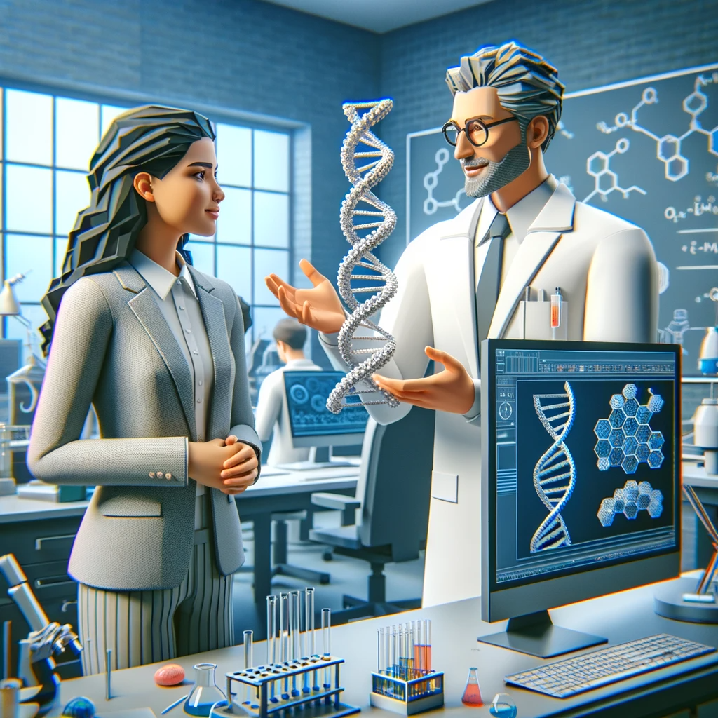
The detailed reading: Introduction
Leads into the topic:
Starts wide, introduces the field as a whole and the relevance
Explains previous literature and its implications and insights
Explains the knowledge gap (what is missing in science)
Introduces the concept of the paper, its goals, and the structure
Why is the paper relevant?
discord.gg/7MJjQ3f
twitch.tv/intuitivexrlabs

Slide 15
The detailed reading: Introduction
Mark different topics
Ask ChatGPT for a brief overview of that topic
Take note of key references and check them briefly (see before)
Try to sum up each paragraph in one or two sentences
You can use ChatGPT for this
Visualize the logical flow of the introduction
Distill the research questions and hypotheses!
discord.gg/7MJjQ3f
twitch.tv/intuitivexrlabs

Slide 16

The detailed reading: Discussion
Yes, Discussion directly after Introduction
Assume the methods are sound
The Discussion should:
Sum up the methods and the results
Interpret the results
Put the results in context of the research questions and hypotheses
Explain the limitations of the study
Explain the implications of the findings for the field
discord.gg/7MJjQ3f
twitch.tv/intuitivexrlabs

Slide 17
The detailed reading: Discussion
Summarize each paragraph
Are the results explained well?
Do the results justify the conclusions?
Are all hypotheses discussed?
Are limitations shown?
Is the research put into context of other research?
Are the implications for the field shown?
What did the researchers find?
discord.gg/7MJjQ3f
twitch.tv/intuitivexrlabs

Slide 18
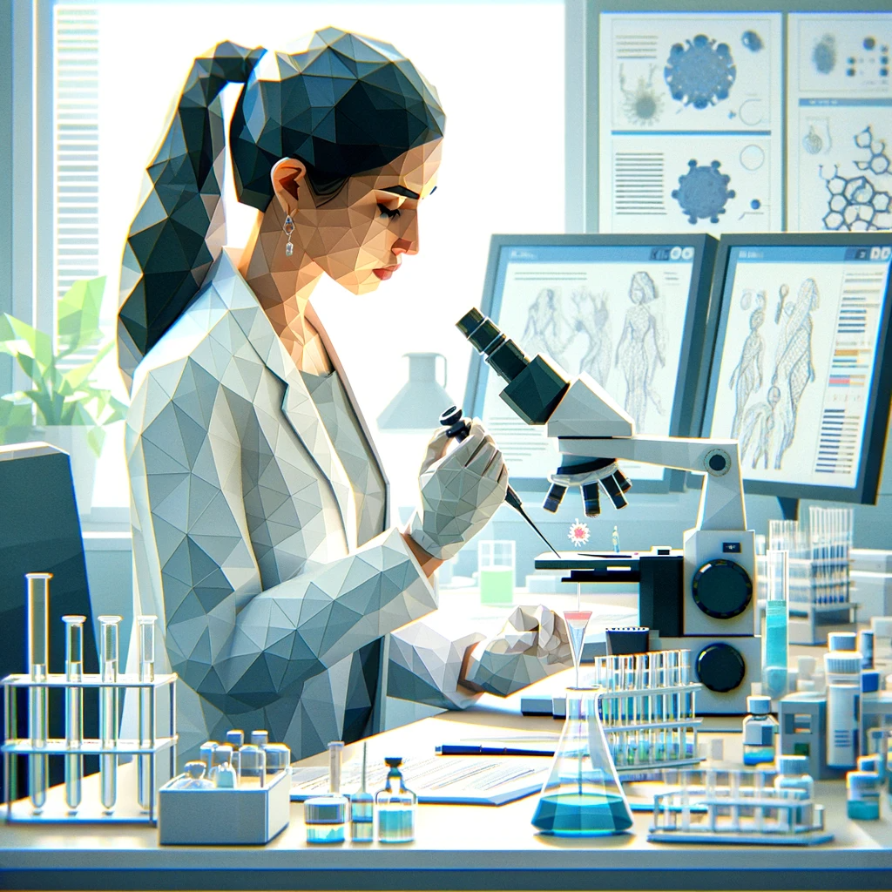
The detailed reading: Methods
Methods must:
Show everything that is necessary to replicate the study
Address the research question and allow falsification of the hypotheses
Show population sample, experimental task, apparatus, data analysis, and statistical approach
Ask ChatGPT to explain you things!
discord.gg/7MJjQ3f
twitch.tv/intuitivexrlabs

Slide 19
The detailed reading: Methods
Summarize each paragraph
Visualize the experimental paradigm
Think! Before reading the results, think about what you expect – what figures or tables should be shown? What Results do you expect? What would make you question the validity of the results?
What did the researchers actually do?
discord.gg/7MJjQ3f
twitch.tv/intuitivexrlabs

Slide 20

The detailed reading: Results
Results must:
Show all relevant data
Show statistics (effect sizes, p-values)
Results should:
Visualize the results in figures
Figure caption, axes labels, legends
Error bars / box plots / sample points
Results must not:
Interpret the data
Ask ChatGPT to explain you things!
discord.gg/7MJjQ3f
twitch.tv/intuitivexrlabs

Slide 21
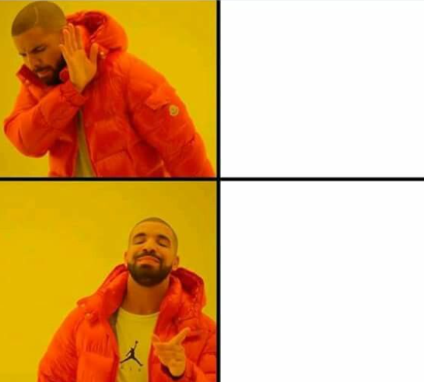
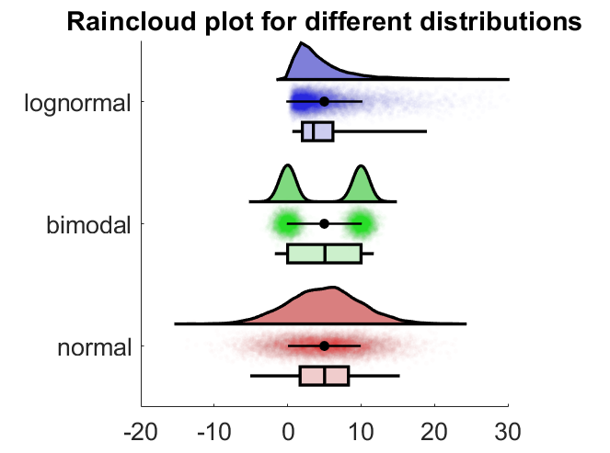
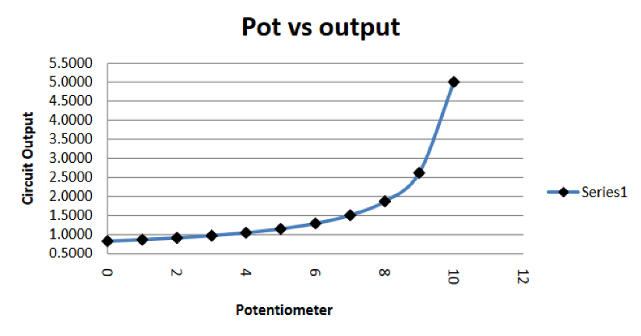
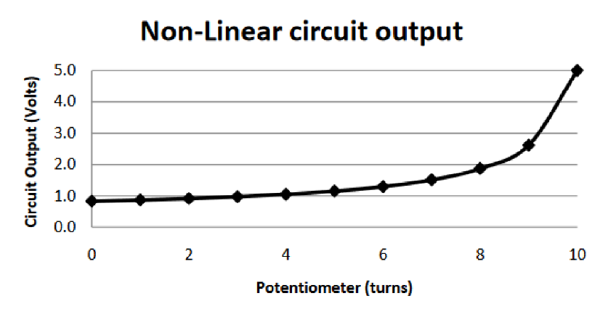
Excursion: Good scientific figures
discord.gg/7MJjQ3f
twitch.tv/intuitivexrlabs

Slide 22
The detailed reading: Discussion II
Yes, Discussion again
You now know the methods and the results
Check the discussion for:
Missing explanations of results
Missing limitations
Flaws in logical reasoning
Are the interpretations justified?
Can the findings be trusted?
discord.gg/7MJjQ3f
twitch.tv/intuitivexrlabs

Slide 23

The detailed reading: Conclusions
Answer these questions to yourself:
What was the research investigating?
Why did the research investigate this?
What was found?
Are the findings unusual or do they support other research in the field?
What are the implications of the results?
What experiments could be carried out to answer any further questions?
discord.gg/7MJjQ3f
twitch.tv/intuitivexrlabs

Slide 24
Read actively!
discord.gg/7MJjQ3f
twitch.tv/intuitivexrlabs

Slide 25
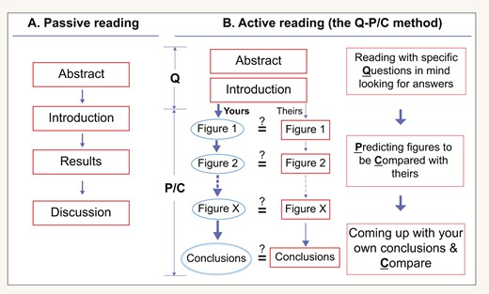
Tung-Tien Sun, Active versus passive reading: how to read scientific papers?, National Science Review, Volume 7, Issue 9, September 2020, Pages 1422–1427, https://doi.org/10.1093/nsr/nwaa130
discord.gg/7MJjQ3f
twitch.tv/intuitivexrlabs

Slide 26

Relevant tools
discord.gg/7MJjQ3f
twitch.tv/intuitivexrlabs

Slide 27
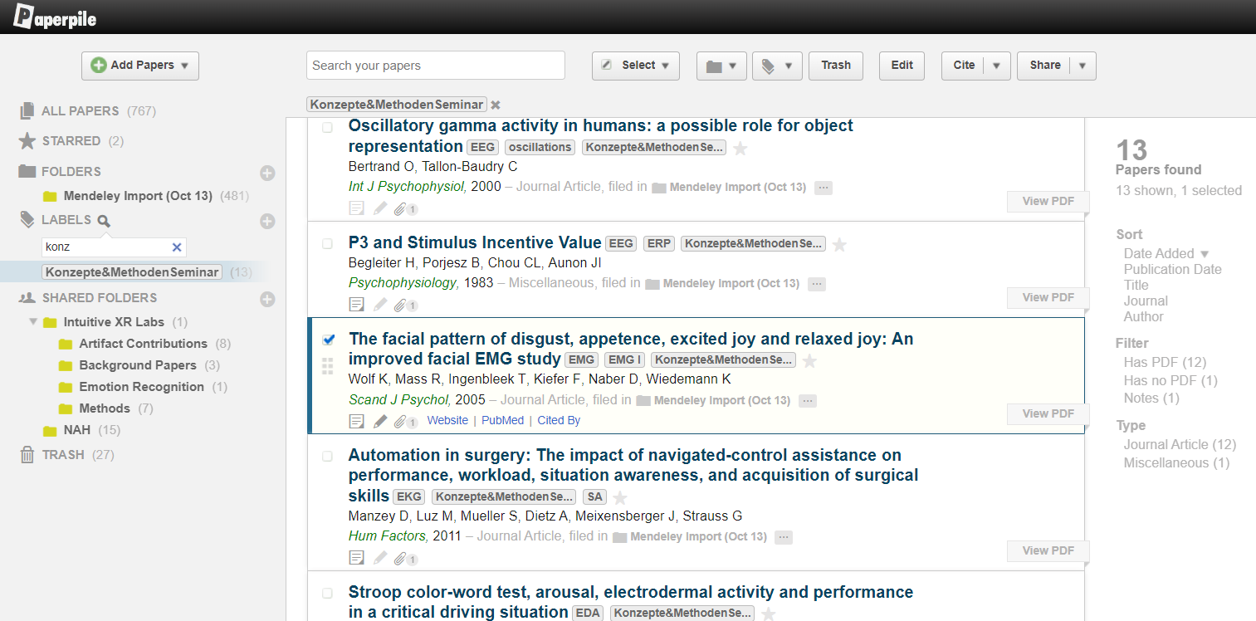
Paperpile
Organize Papers, easy citation in Google Docs or MS Word, annotate, take notes
Not free…
https://paperpile.com/app
discord.gg/7MJjQ3f
twitch.tv/intuitivexrlabs

Slide 28
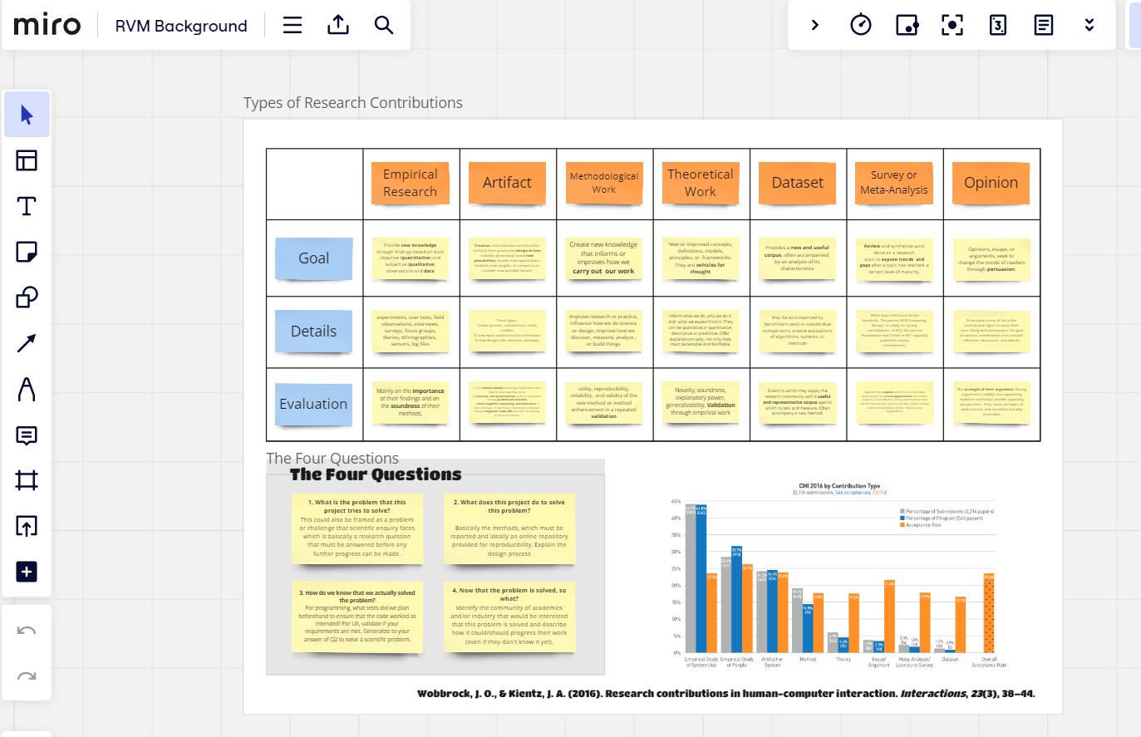
Miro
Sticky notes for thought organization, note taking, ideation
Free academic license
https://miro.com/
discord.gg/7MJjQ3f
twitch.tv/intuitivexrlabs

Slide 29
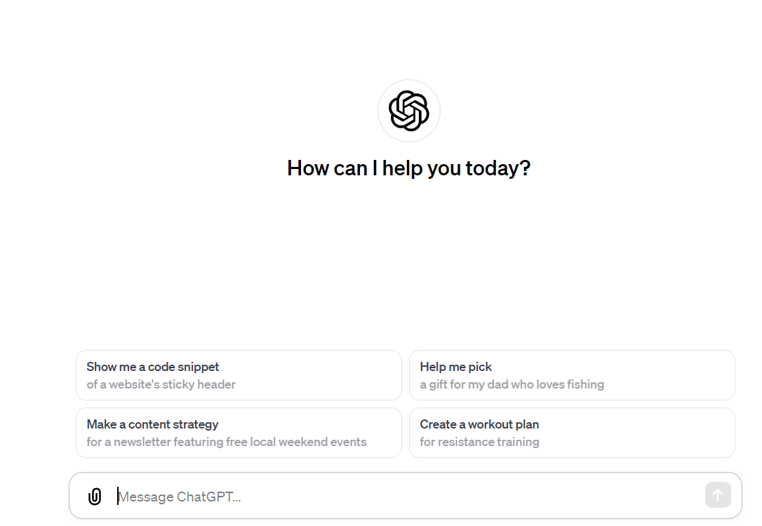
ChatGPT
https://chat.openai.com/
Summaries, basic questions
NOT: critical thinking
discord.gg/7MJjQ3f
twitch.tv/intuitivexrlabs

Slide 30
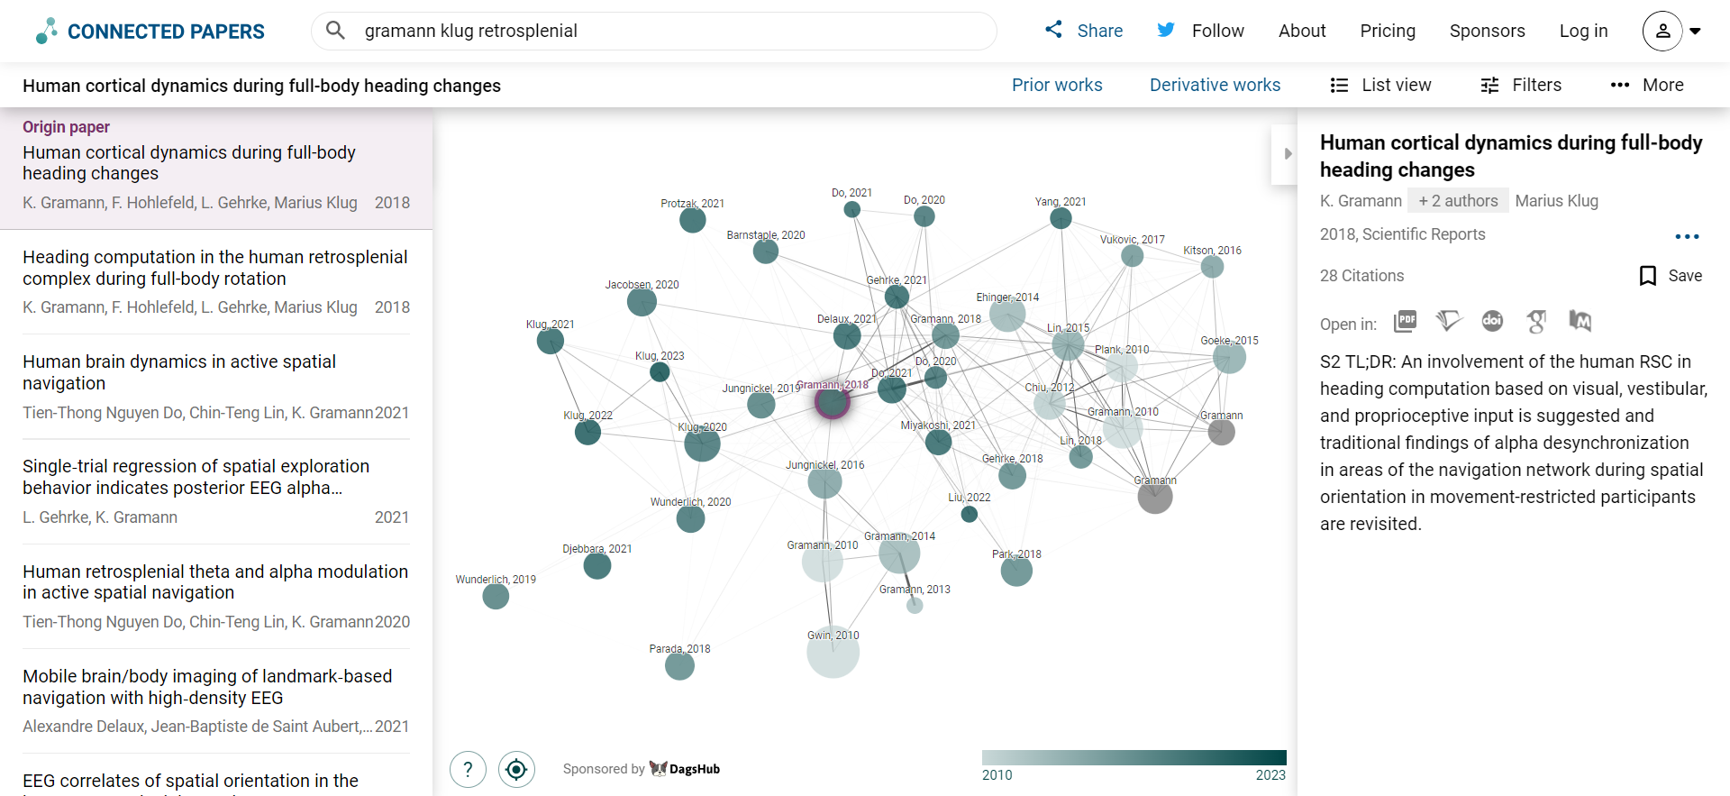
Connected
Papers
https://www.connectedpapers.com/
Finding related research
discord.gg/7MJjQ3f
twitch.tv/intuitivexrlabs

Slide 31
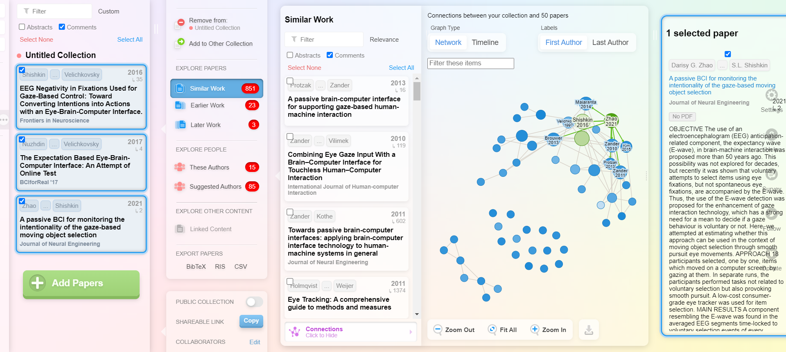
Research
Rabbit
https://researchrabbitapp.com/
Finding related research
discord.gg/7MJjQ3f
twitch.tv/intuitivexrlabs

Slide 32
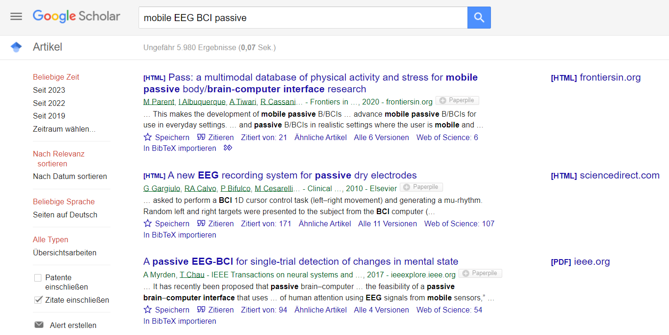
Google
Scholar
https://scholar.google.com/
Finding related research
discord.gg/7MJjQ3f
twitch.tv/intuitivexrlabs

Slide 33
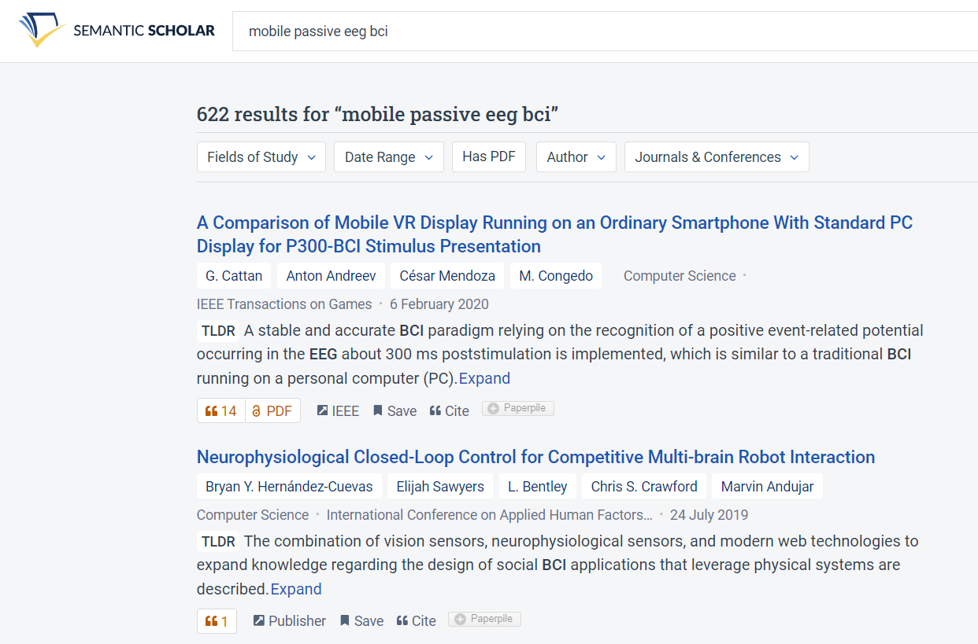
Semantic
Scholar
https://www.semanticscholar.org/
Finding related research
discord.gg/7MJjQ3f
twitch.tv/intuitivexrlabs

Slide 34
Resources
https://web.stanford.edu/class/ee384m/Handouts/HowtoReadPaper.pdf
https://www.eecs.harvard.edu/~michaelm/postscripts/ReadPaper.pdf
https://www.ncbi.nlm.nih.gov/pmc/articles/PMC3687192/
https://blogs.lse.ac.uk/impactofsocialsciences/2016/05/09/how-to-read-and-understand-a-scientific-paper-a-guide-for-non-scientists/
https://bitesizebio.com/11060/how-to-read-a-scientific-paper/
https://www.science.org/content/article/how-seriously-read-scientific-paper
https://academic.oup.com/nsr/article/7/9/1422/5859953
discord.gg/7MJjQ3f
twitch.tv/intuitivexrlabs

